Slide 1
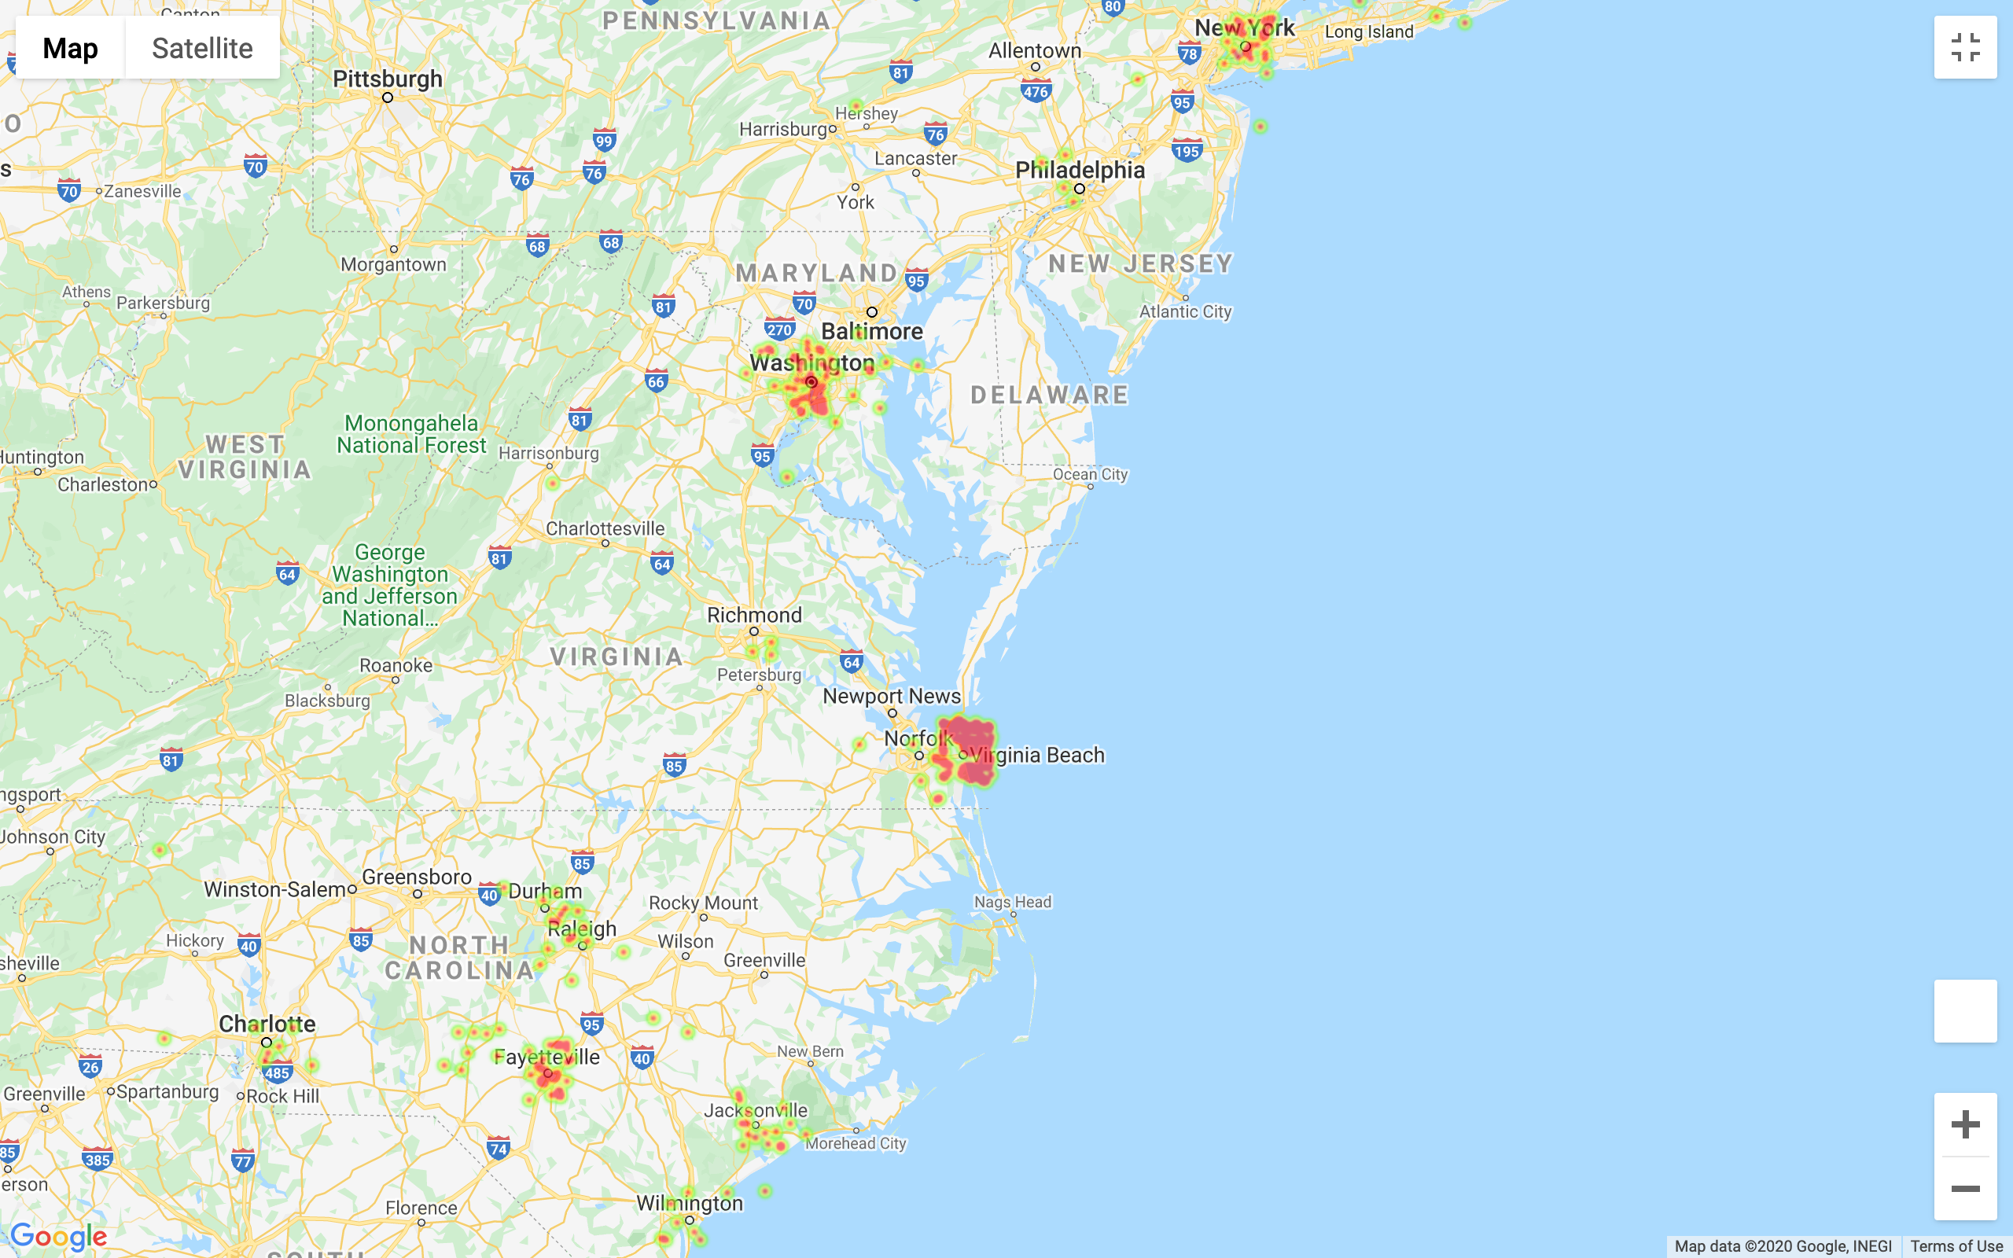
East Coast Distribution
Wannabe bankers
Policy wonks
Green Berets
Navy
SEALs
Marine Raiders
Marine Raiders

Slide 2
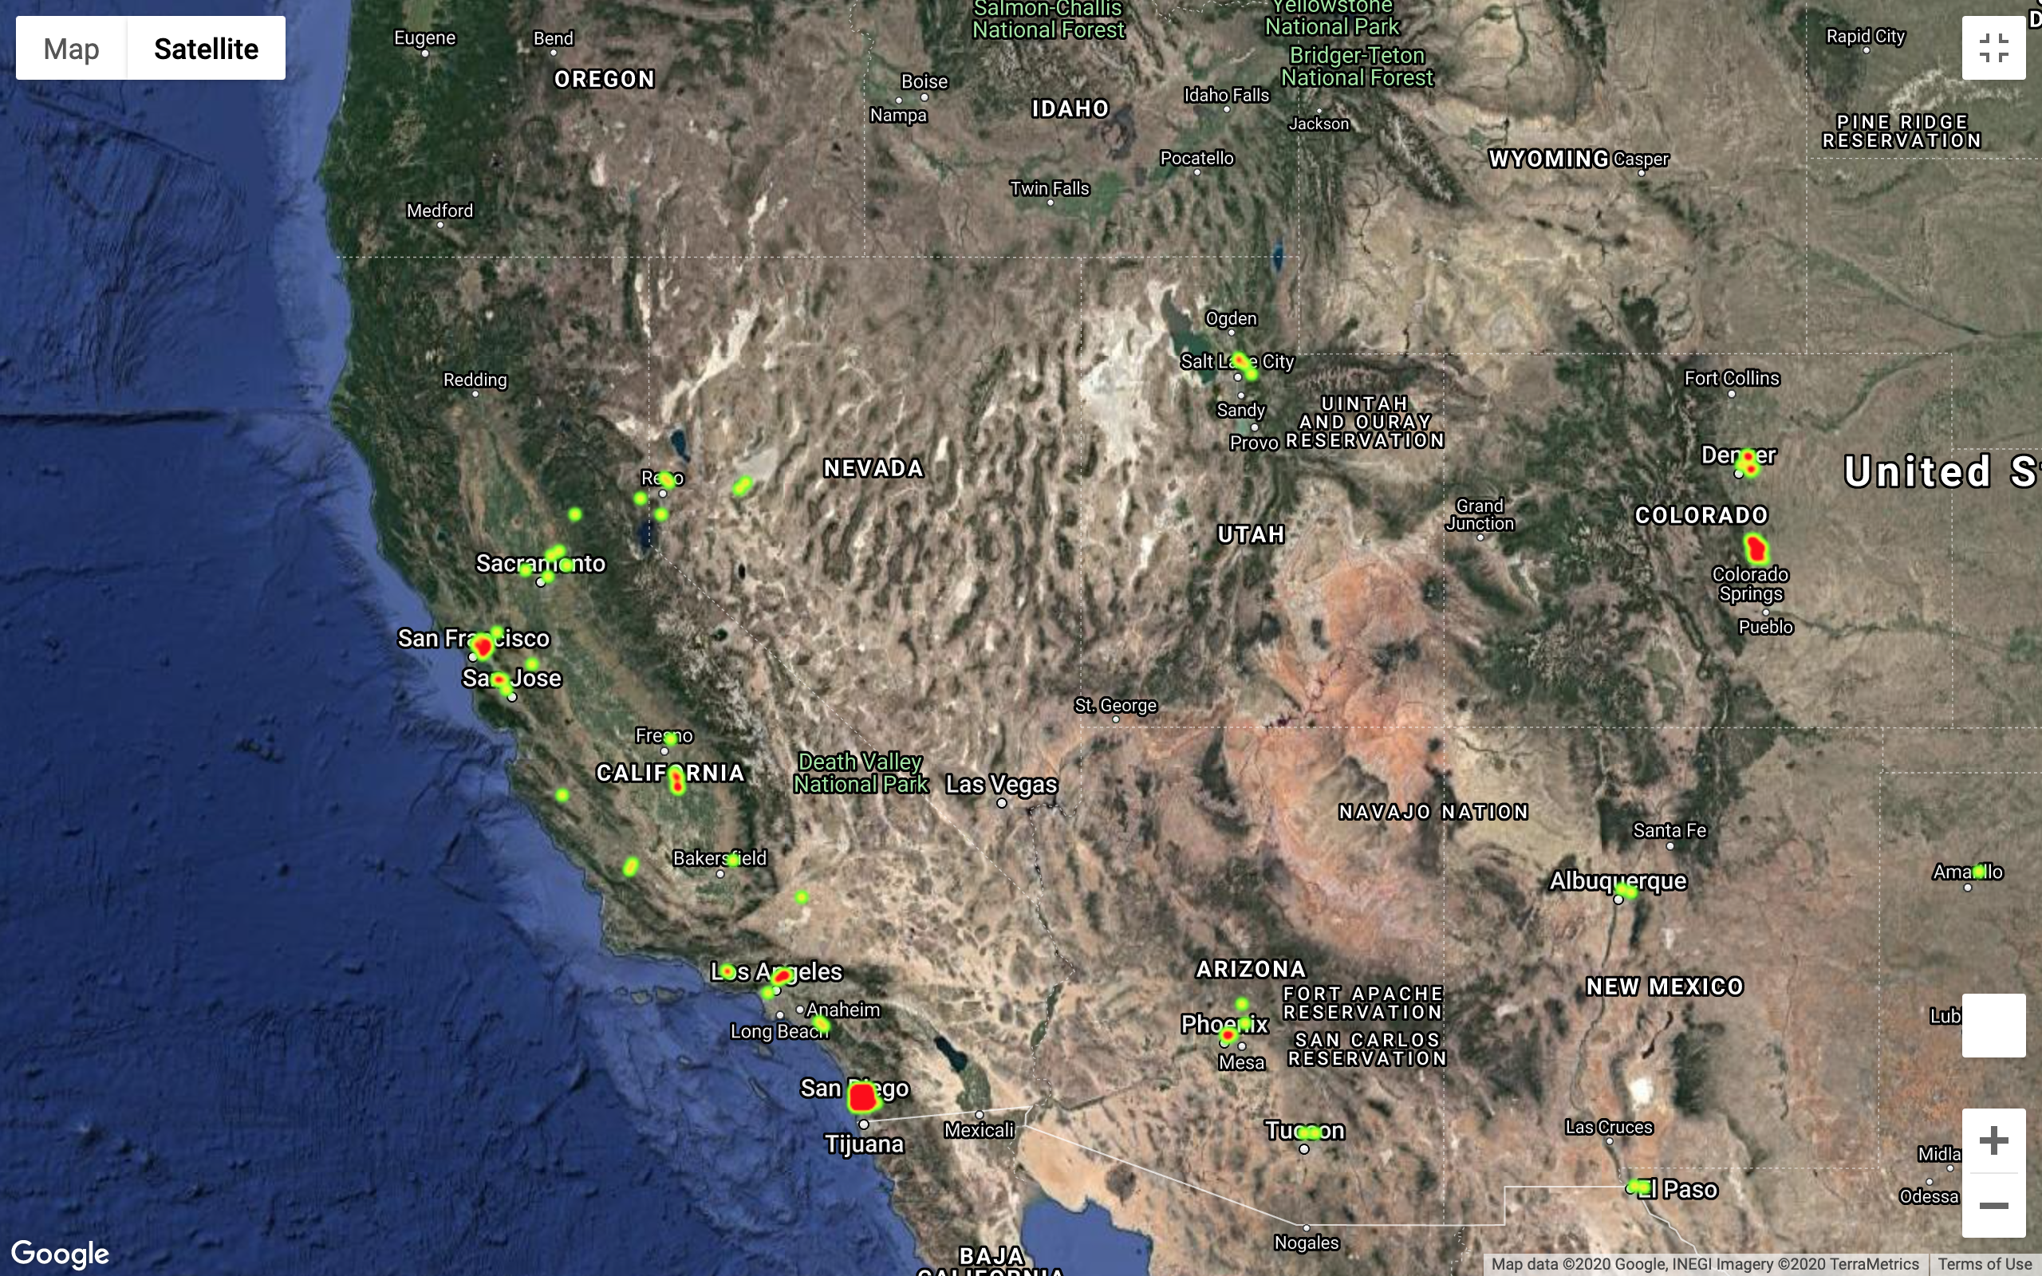
West Coast Distribution

Slide 3
